Slide 1
Build a Rod
Part 5
By JOHN STURM

Slide 2
Putting the rod together: Removing air bubbles
The alcohol candle works great for removing trapped air bubbles in the epoxy. Epoxy is not flammable. Heat the guide wraps while the rod is turning in the dryer. Stop heating when the bubbles are gone. Keep the flame moving left and right. Holding it too long in one place causes epoxy to turn black.

Slide 3
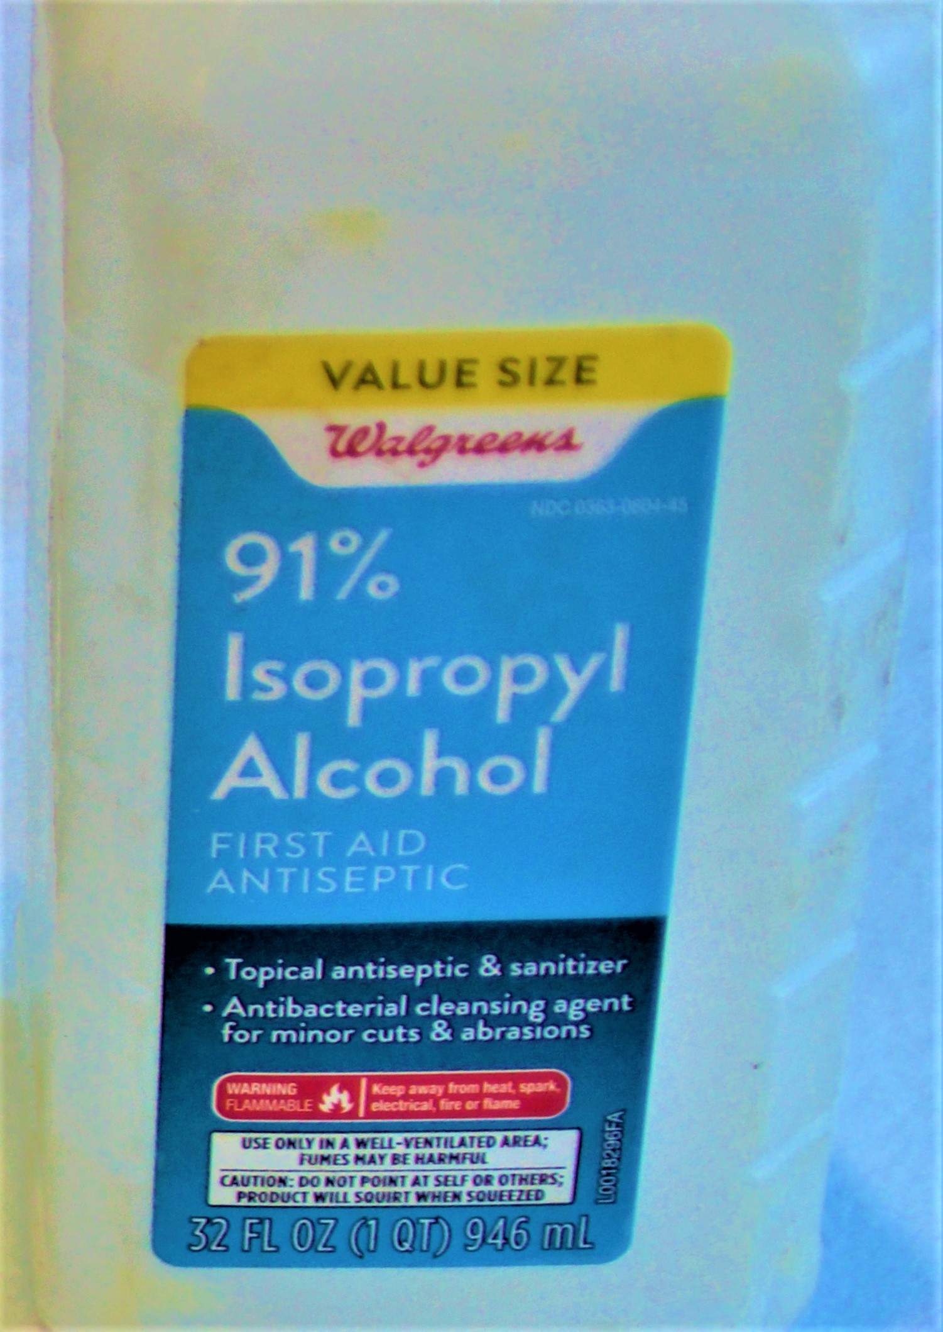
Putting the rod together: Epoxy Finish clean up
Isopropyl Alcohol is a cleaner for epoxy. Brushes, stir stick, mixing cup, etc. may be cleaned with alcohol. All may be re-used.

Slide 4
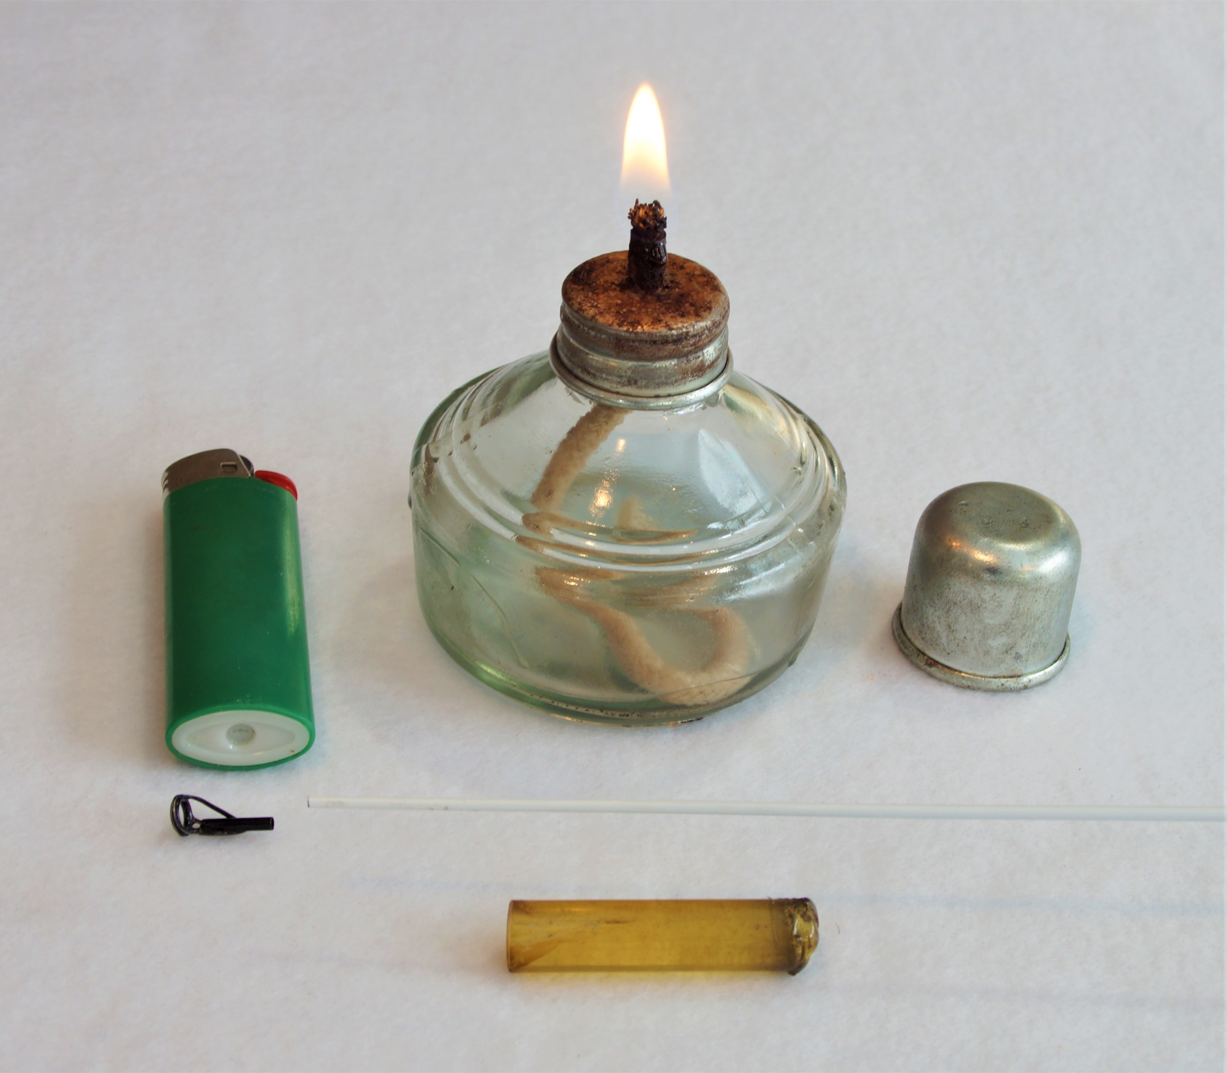
Putting the rod together: Installing the Tip Top
Tip tops are installed with a heat sensitive glue (Do not use epoxy). The alcohol candle using 91% rubbing alcohol works well for this step. A lighter will also work. Heat one end of the glue and apply it to the tip of the rod. Keep it warm as you slide on the tip top into the correct aligned position. BE CAREFUL NOT TO BURN YOURSELF!

